Slide 1
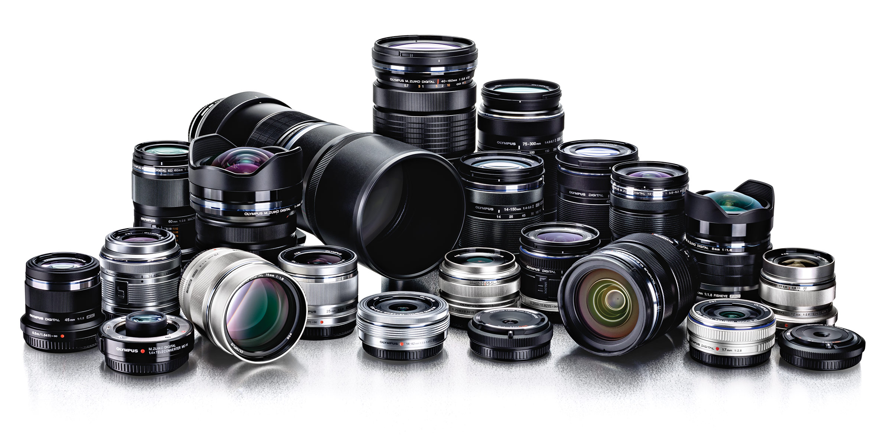

SECONDHAND LENS BUSINESS INTELLIGENCE PROJECT
SOLUTION PROPOSAL
JOANNE LEW, ERIC SEE, ARIES WIBOWO
8th JUNE 2018

Slide 2




WHO WE ARE
ERIC
SOLUTION ARCHITECT
JOANNE
DATA INTEGRATION SPECIALIST
ARIES
BUSINESS REPORT SPECIALIST

Slide 3

PROPOSAL BACKGROUND

Slide 4
CURRENT IMPLEMENTATION
RESOURCE BOTTLENECK
---------------
BUSINESS USER HIGH DEPENDENCY ON IT DEPARTMENT
REPORT TYPE LIMITATION
---------------
COST TO BUILD DIFFERENT REPORT TYPES IS VERY HIGH
AD HOC DATA EXTRACTION
---------------
REPORT NOT AUTOMATICALLY UPDATED ON TIMELY MANNER

Slide 5
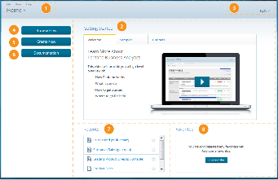
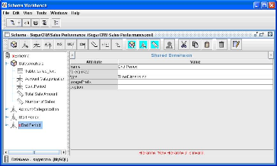
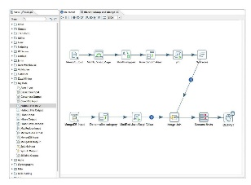
PENTAHO TECHNOLOGY
RESOURCE BOTTLENECK
---------------
BUSINESS USER HIGH DEPENDENCY ON IT DEPARTMENT
REPORT TYPE LIMITATION
---------------
COST TO BUILD DIFFERENT REPORT TYPES IS VERY HIGH
AD HOC DATA EXTRACTION
---------------
REPORT NOT AUTOMATICALLY UPDATED ON TIMELY MANNER
PENTAHO USER CONSOLE
MODELLING TOOLS
PENTAHO DATA INTEGRATION

Slide 6
FUTURE IMPLEMENTATION
PRODUCTIVE RESOURCE
---------------
BUSINESS USER SELF SERVICE
REPORT TYPE FLEXIBILITY
---------------
DIFFERENT REPORT TYPES WITH NO ADDITIONAL COST
AUTOMATED DATA EXTRACTION
---------------
REPORT UPDATED ON TIMELY MANNER
PENTAHO DATA INTEGRATION
PENTAHO USER CONSOLE
PENTAHO DATA INTEGRATION
PENTAHO USER CONSOLE
MODELLING TOOLS
MODELLING TOOLS

Slide 7
PROPOSED SOLUTION

Slide 8
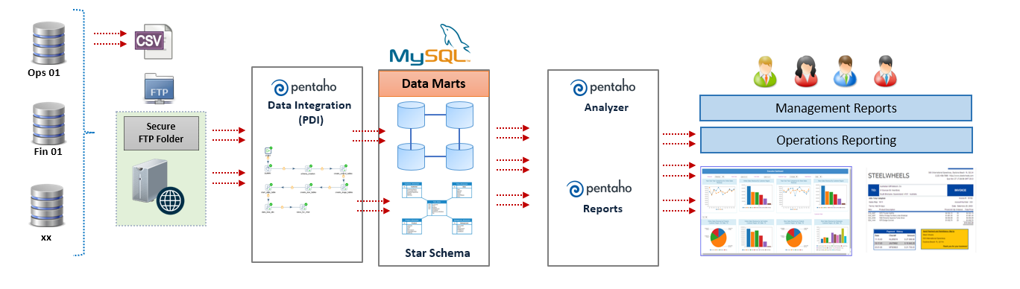
SOLUTION ARCHITECTURE (PHASE 1)
INGESTION & ABSTRACTION
ENRICHMENT
REPORTING & PRESENTATION
Import data from excel in shared folder to sls_raw and
transform and insert it to agile_sls and sls_dma
Creating Mondrian schema & metadata model
Report creation and use

Slide 9
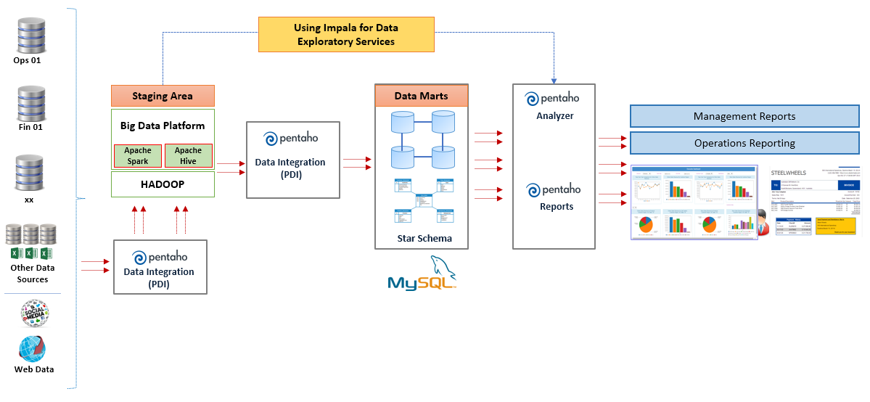
SOLUTION ARCHITECTURE (PHASE 2)

Slide 10
DEMO QUESTION AND ANSWER

